Slide 1
OVERVIEW OF THE ACCESSIBLE CANADA ACT
EMPOWER U: LEARN TO ACCESS YOUR DEAF RIGHTS & DISABILITY RIGHTS
OVERVIEW OF THE ACCESSIBLE CANADA ACT
Notes:
Translate

Slide 2
PURPOSE
Notes:
The bill is to benefit all persons, especially persons with disabilities, through the realization, within the purview of matters coming within the legislative authority of Parliament, of a Canada without barriers, particularly by the identification and removal of barriers, and the prevention of new barriers, in the following areas:
(a) employment;
(b) the built environment;
(c) information and communication technologies;
(c.‍1) communication, other than information and communication technologies;
(d) the procurement of goods, services and facilities;
(e) the design and delivery of programs and services;
(f) transportation; and
(g) areas designated under regulations made under paragraph 117(1)‍(b)

Slide 3
WHERE DOES IT APPLY?
The Accessible Canada Act applies to organizations under federal responsibility (“regulated entities”):
the Government of Canada, including government departments, Crown Corporations and agencies
the federally regulated private sector, including organizations in the transportation sectors, broadcasting and telecommunications services, and the banking and financial sectors;
Parliament, including the Senate, the House of Commons, the Library of Parliament and the Parliamentary Protective Service; and,
the Canadian Forces and the Royal Canadian Mounted Police.

Slide 4
DUTIES OF REGULATED ENTITIES
Notes:
Accessibility Plans and Reports:
Federally regulated organizations would have to publish accessibility plans and reports on preventing and removing barriers. They would have to consult with people with disabilities and Deaf people in preparing their plans.
Feedback
Processes
Organizations would have to establish a process for receiving and dealing with feedback about barriers.

Slide 5
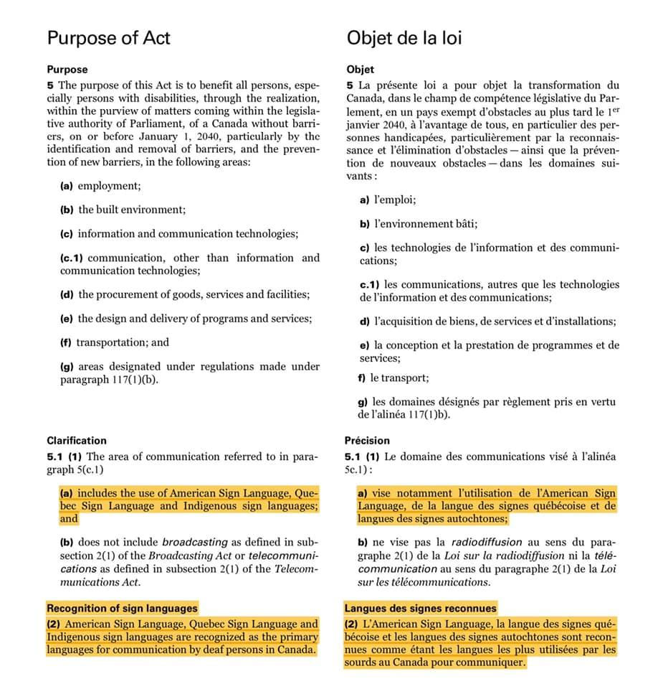
The Accessible Canada Act establishes new structures and positions, including:
the Canadian Accessibility Standards Development Organization (CASDO), which will be led by a board of directors comprised of a majority of persons with disabilities and will develop accessibility standards in collaboration with industry and the disability community;
a Chief Accessibility Officer (CAO), who will provide advice to the Minister of Accessibility and monitor systemic and emerging accessibility issues; and
the Accessibility Commissioner, who will spearhead compliance and enforcement activities under the legislation including monetary penalties.
Notes:
This new organization would develop and review accessibility standards, which would create legal obligations. The majority of its Board members would be people with disabilities and Deaf people. The organization will oversee activities and give advice to Chief Executive Officer.
The Chief Executive Officer will be responsible for:
submit an annual report to the Minister responsible for Accessibility, who would then table it in Parliament;
the development and revision of accessibility standards;
the recommendation of standards to the Minister responsible for Accessibility;

Slide 6
COUNCIL OF FEDERAL ACCESSIBILITY AGENCIES
Requires the member organizations of the Council to work collaboratively to refer federal accessibility complaints to the right organization and to foster complementary policies and practices. The Council is made up of:
the Chair and Chief Executive Officer of the Canadian Transportation Agency;
the Chair and Chief Executive Officer of the Canadian Radio-television and Telecommunications Commission;
the Chair of the Canadian Human Rights Tribunal;
the Chair of the Federal Public Sector Labour Relations and Employment Board;
the Chief Commissioner of the Canadian Human Rights Commission, serving as Chair; and
the Accessibility Commissioner
Notes:
The Canadian Radio-television and Telecommunications Commission (CRTC) would continue handling complaints regarding barriers in broadcasting and telecommunications.
The Canadian Transportation Agency (CTA) would continue handling complaints regarding travel between provinces by air, rail, bus or ferry.
The Federal Public Sector Labour Relations and Employment Board would be responsible for complaints by federal public servants and Parliamentary employees.
All other complaints would be submitted and decided by the Accessibility Commissioner.

Slide 7
LEGISLATION VS REGULATIONS
Legislation…
Is passed by Parliament.
Provides the legal framework for making regulations.
Sets out:
Who is allowed to make regulations.
Who is allowed to enforce the regulations.
Who the regulations apply to.
Regulations…
Are made by:
The Governor in Council (i.e., Treasury Board).
A minister.
An agency or other body of government.
Are made via a process internal to Government and are not passed by Parliament.
Are legal texts that contain the actual rules.

