Slide 1
Using the CRPD to Advance the Right to Health
Melanie Benard
Empower U Webinar Series
February 26, 2020

Slide 2
Outline
CRPD: Article 25
Canada’s Legal Framework
Barriers to Health Care
Legal Cases

Slide 3
CRPD - Article 25
The Right to Health

Slide 4
CRPD - Article 25
People with disabilities have the right to the highest attainable standard of health without discrimination
Notes:
States Parties recognize that persons with disabilities have the right to the enjoyment of the highest attainable standard of health without discrimination on the basis of disability.

Slide 5
CRPD - Article 25
Health services must be gender-sensitive, including health-related rehabilitation.
Notes:
States Parties shall take all appropriate measures to ensure access for persons with disabilities to health services that are gender-sensitive, including health-related rehabilitation.

Slide 6
CRPD - Article 25
Access to the same range, quality and standard of free or affordable health care
Sexual and reproductive health
Public health
Notes:
b) Provide those health services needed by persons with disabilities specifically because of their disabilities, including early identification and intervention as appropriate, and services designed to minimize and prevent further disabilities, including among children and older persons; (c) Provide these health services as close as possible to people’s own communities, including in rural areas; (d) Require health professionals to provide care of the same quality to persons with disabilities as to others, including on the basis of free and informed consent by, inter alia, raising awareness of the human rights, dignity, autonomy and needs of persons with disabilities through training and the promulgation of ethical standards for public and private health care; (e) Prohibit discrimination against persons with disabilities in the provision of health insurance, and life insurance where such insurance is permitted by national law, which shall be provided in a fair and reasonable manner; (f) Prevent discriminatory denial of health care or health services or food and fluids on the basis of disability.

Slide 7
CRPD – Article 25
Disability-related health services
Early identification and intervention
Services to prevent further disabilities
Notes:
States Parties shall:
(b) Provide those health services needed by persons with disabilities specifically because of their disabilities, including early identification and intervention as appropriate, and services designed to minimize and prevent further disabilities, including among children and older persons;

Slide 8
CRPD – Article 25
Services as close as possible to people’s communities, including in rural areas
Notes:
(c) Provide these health services as close as possible to people’s own communities, including in rural areas;

Slide 9
CRPD – Article 25
Care of the same quality that is provided to others
Free and informed consent
Article 12: Legal capacity
Notes:
Require health professionals to provide care of the same quality to persons with disabilities as to others, including on the basis of free and informed consent.
Link with article 12: legal capacity. Substitute decision making vs supported decision-making.

Slide 10
CRPD – Article 25
Raise awareness of the human rights, dignity, autonomy and needs of people with disabilities
Training
Ethical standards
Notes:
Raising awareness of the human rights, dignity, autonomy and needs of persons with disabilities through training and the promulgation of ethical standards for public and private health care;

Slide 11
CRPD – Article 25
Prohibit discrimination in health and life insurance
Notes:
Prohibit discrimination against persons with disabilities in the provision of health insurance, and life insurance where such insurance is permitted by national law, which shall be provided in a fair and reasonable manner;

Slide 12
CRPD – Article 25
Prevent discriminatory denial of health care or food and fluids based on disability.
Notes:
(f) Prevent discriminatory denial of health care or health services or food and fluids on the basis of disability.

Slide 13
CRPD
Article 26:
The Right to Rehabilitation
Notes:
States Parties recognize that persons with disabilities have the right to the enjoyment of the highest attainable standard of health without discrimination on the basis of disability.

Slide 14
Right to Rehabilitation (Art.26)
Maximum independence
Early intervention
Multidisciplinary evaluations
Inclusion in the community

Slide 15
Right to Rehabilitation (Art.26)
Voluntary participation
Rural and urban
Training for professionals
Assistive devices and technologies

Slide 16
Canada’s Legal Framework

Slide 17
Legal Framework
Who controls health care in Canada?
Provinces:
Hospitals, health care workers, insurance
Federal government:
Funding, Indigenous, refugees, military

Slide 18
Legal Framework
Charter of Rights and Freedoms
Doesn’t guarantee the right to health, BUT:
Right to equality
Right to life, liberty and security of the person

Slide 19
Legal Framework
Human rights laws
Right to equality and non-discrimination
Human rights complaints

Slide 20
Legal Framework
Provincial accessibility laws:
Ontario (AODA)
Manitoba
Nova Scotia

Slide 21
Legal Framework
CRPD + Optional Protocol
Canada must submit reports
Individuals can file complaints with UN Committee
Notes:
If a person believes that their CRPD rights were violated, they can make a complaint. They must be personally and directly affected by the violation. Only after the person has already gone through all the relevant complaint procedures available in Canada. These could include legal complaint procedures like making a human rights complaint or going to court. These could also include administrative complaint procedures like asking a government official to review their decision.
When CRPD rights are found to have been violated, the Committee will make recommendations to the Government of Canada about steps it should take to stop or prevent the rights violation. It is up to governments to decide whether to follow the Committee’s recommendations.

Slide 22
Barriers to Health Care

Slide 24
Barriers: Physical
Buildings:
Stairs, doorways, washrooms
Equipment:
Exam tables, machines
Transportation:
Public transit, parking spots

Slide 25
Barriers: Attitudes
Medical model
Bias and assumptions
Capacity and quality of life
Ignorance about disability
Insensitivity
Notes:
Ignorance about disability
Treatment options
Misjudging impact on person’s life (too much or too little)

Slide 26
Barriers: Communication
Interpreters or assistance
Ex: ASL and LSQ
Plain language
Websites

Slide 27
Barriers: Systemic
Training
Few health care workers with disabilities
Time constraints
Avoid “complex” patients
Funding cuts (ex. home care)
Medication and equipment not always covered

Slide 28
Intersectionality
Some people with disabilities face even more barriers
Ex. Women, Indigenous, people of colour, LGBTQ+

Slide 29
Consequences
Distrust of medical system
History of abuse
Unmet health needs
Poorer health outcomes
Notes:
More than 3 times as many unmet health needs as people without disabilities.
Poorer health outcomes: People with disabilities are less likely to have access to preventive care such as breast cancer and cervical cancer screening.

Slide 30
Legal Cases

Slide 31
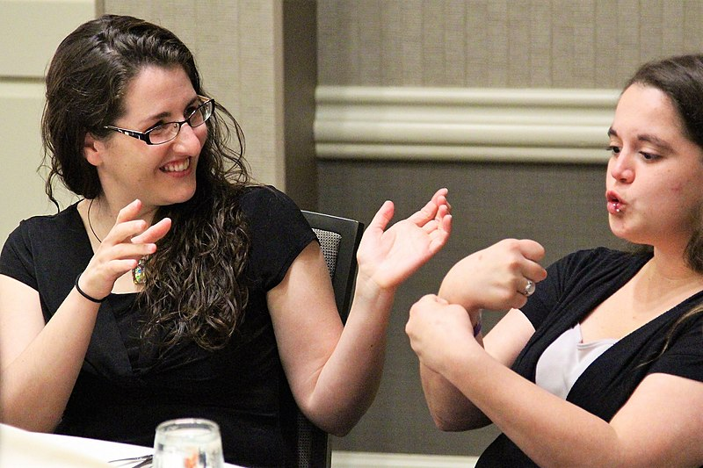
Legal Cases
Eldridge case (1997):
Hospitals must provide sign language interpreters for Deaf people

Slide 32
Legal Cases
Auton case (2004):
The government doesn’t have to fund intensive behaviour therapy for children with autism

Slide 33
Legal Cases
Carter case (2015):
Medical assistance in dying (MAID)
Section 7 of the Charter
Right to life, liberty and security

Slide 34
Legal Cases
Response to Carter:
Federal Law (C-14)
Death must be “reasonably foreseeable”
Truchon case (Quebec – 2019)
Death doesn’t have to be “reasonably foreseeable”

Slide 35
Legal Cases
MacLaren case (BC - ongoing):
Legal capacity + consent
“Presumed consent” if hospitalized against your will
Waiting for Court of Appeal decision
Complaint using CRPD Optional Protocol?

Slide 36
Conclusion
Using the CRPD to improve access to health care:
Filing complaints / legal cases
Responding to Canada’s CRPD reports
Talking to the media
Pressuring government

Slide 37
QUESTIONS ?

